Slide 1
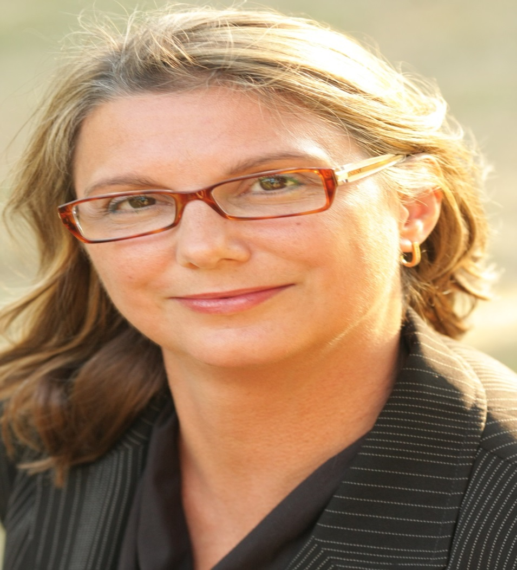
Tammy Knoll-Anderson, MS, ITIL Senior Instructional Design

Slide 2
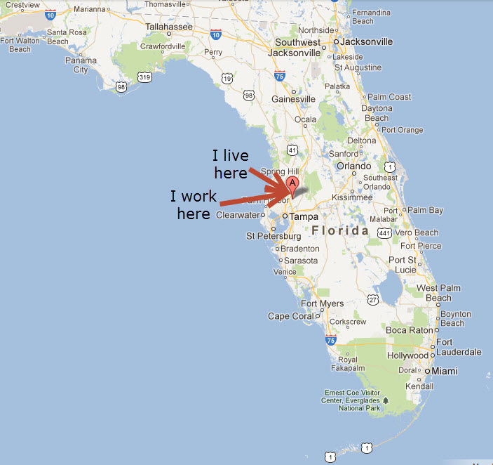

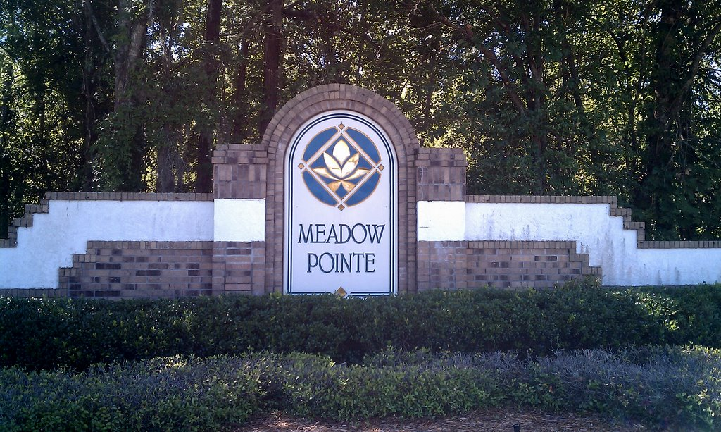

Slide 3

Most days I work from home for B Wyze Solutions:
Designing, building, editing, and quality checking online training courses,
Developing performance support solutions

Slide 4
















For these companies . . .

Slide 5












Using these tools . . .

Slide 6
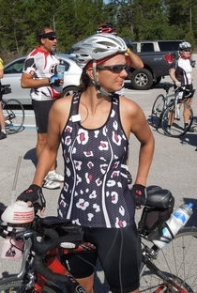
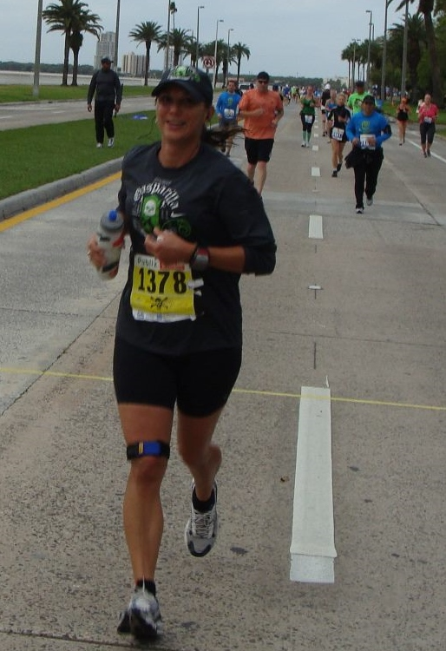
When I’m not designing, I’m doing this . . .
. . . and this.

Slide 7
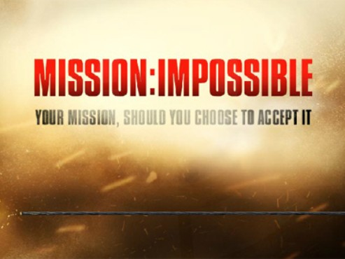
My Mission
To inspire performance excellence and leave a legacy of enhanced processes wherever I go.

Slide 8
Core competencies
Continuous Process Improvement
Report Design
Coaching
Knowledge Manage-ment
Call Quality Assessment
Instructional Design
Writing
I’ve done all these things many times over many years. . .

Slide 9
Steps to Professional Maturity
The Writer
The Designer
1996
1998
2004
2007
2010
The Reporter
The Coach
The Learner
The Teacher
This is how I grew . . .

Slide 10
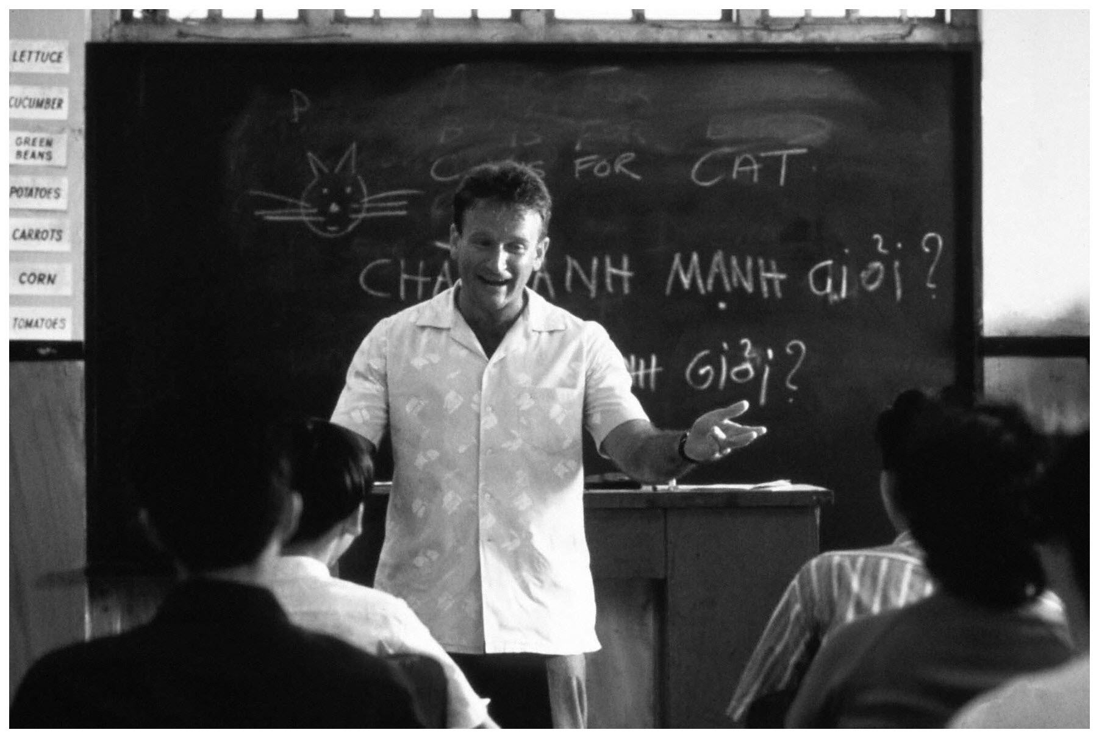
1996
The Teacher

Slide 11

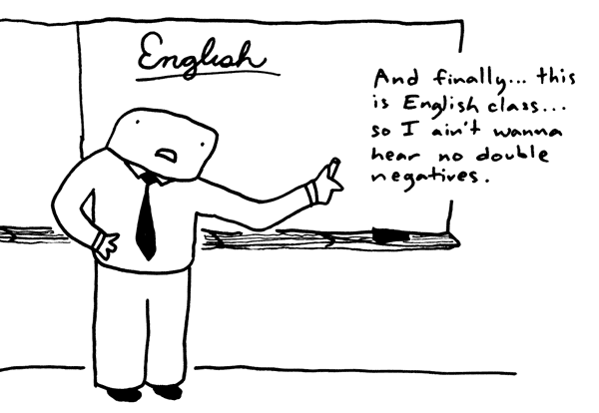

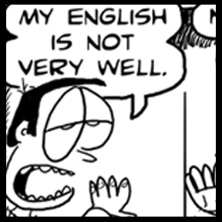
Florida State University
In school, I studied English, then Education, then Multicultural/ Multilingual Education.

Slide 12
After graduation, I developed curriculum and taught English to foreign students, but the schools I worked for kept going out of business.
NWLI
Yazagi
I had to find something else to do.

Slide 13
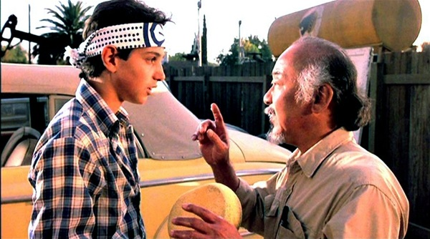
1998 The Learner
Wax on . . . . Wax off

Slide 14

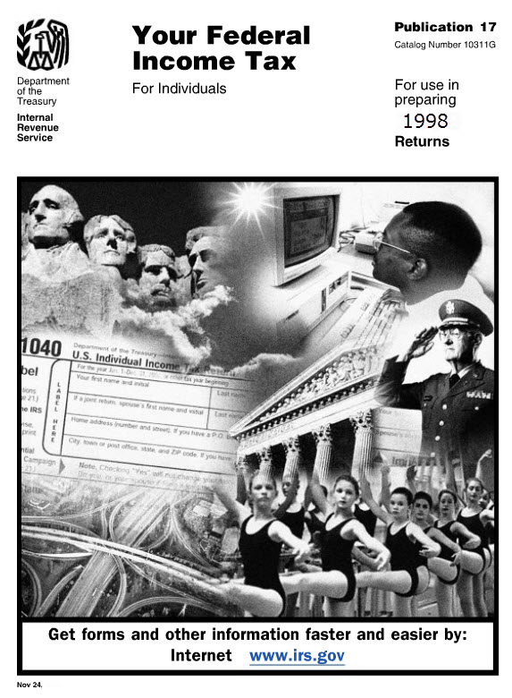
I started climbing the ladder of my call center career supporting A+ Tax software during tax season.
My new supervisor handed me an IRS pub 17 then set me up with a phone to field calls and park tickets in the queue.
My first call center lesson was how to use the pick-and-park strategy of clearing incoming calls off the board.

Slide 15
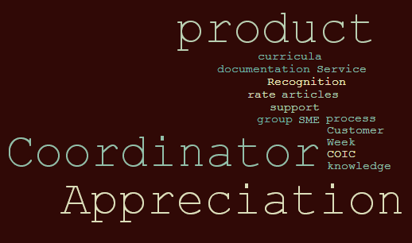
Tax season was TOUGH, but fortunately, I did well enough to get hired on the Andersen service desk after it was over.
I learned fast and was promoted to a Knowledge Management position.
As a Knowledge Manager, I wrote support documentation including knowledge articles, SOPs, training manuals, and instructional guides.

Slide 16



The PwC Years: 2002 – 2010
When Arthur Andersen went out of business, I was fortunate to be immediately hired on with PwC.
With my new team I wrote IT communication alerts, advisories and announcements.
I also compiled our communications team writing standards guide and managed the IT best practice documentation database.
Then, I took calls from PwC auditors for a little while.

Slide 17
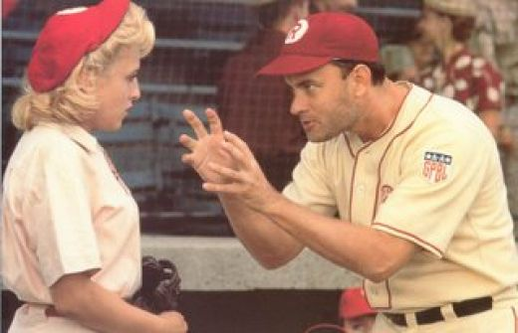
2004
The Coach
“There’s no crying in baseball!”

Slide 18

I became a coach first by assessing the quality of recorded calls for the IT service desk.
My teammate and I designed and built the program from the ground up including the form, scoring, ratings, assessment standards, calibrations, reporting, evaluations, training and individual staff coaching sessions.
This call may be recorded . . .
I LOVED this work, but after a few years I needed a new challenge. I decided I was ready to expand this coaching experience to people management.
. . . For quality and training purposes

Slide 19

So, I became a supervisor the HRSSC call center doing all the things team leads do to assist their manager and coach staff to their highest performance potential . . . for about a year.
. . . . Then I was promoted again.

Slide 20

2007
The Reporter

Slide 21
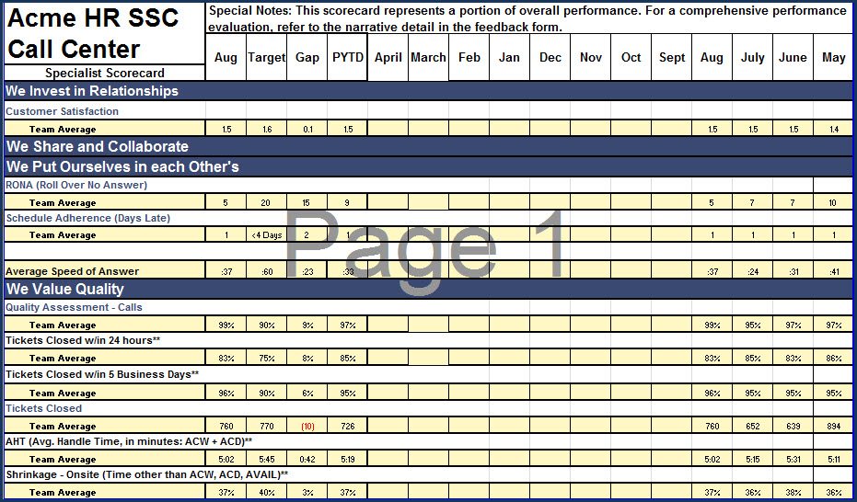
As a new manager, I managed call center systems, processes and reporting. I was still coaching though since our operational manager was brand new to the call center environment. A perfect partnership!
I LOVED delivering performance reports like this example to help leadership make the best possible decisions about call center strategic direction.

Slide 22
After creating a set of reporting analytics for the HR call center, I moved to the HRSSC Reporting team. In this role, I partnered with another reporting manager to create a similar report for EVERY HRSSC department team.
This meant examining all inputs/outputs for each team’s systems and processes to report an accurate account of efficiency, people, cost and quality.
It looked like this . . .

Slide 23
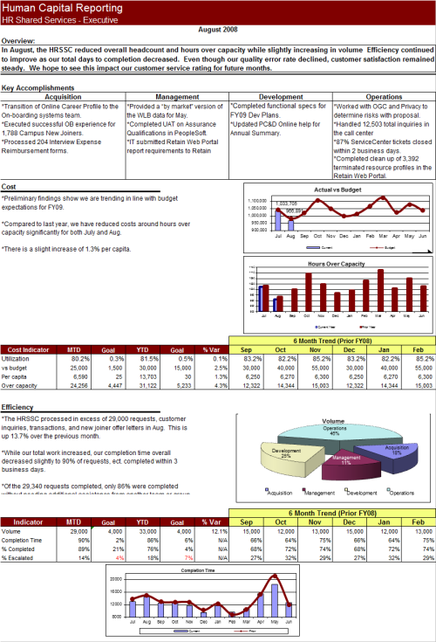
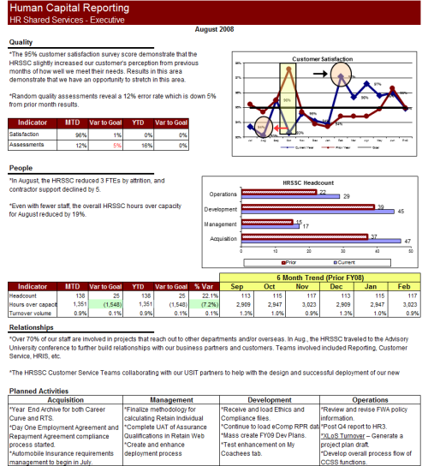

Slide 24

Once that project was completed, the reports were automated and handed over to the reporting team and I started writing again; this time for the HRSSC Process Documentation team.
I managed a project to document SLAs for every HRSSC team and helped build the SOP documentation database.

Slide 25

2010 The designer
Analysis > Design > Development > Implementation > Evaluation

Slide 26

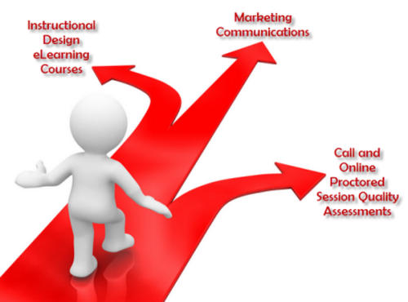
Independent contractor – b wyze solutions
I love the creative aspect of designing curriculum and building screens in SH!FT. I’m able to use my academics and experience as an educator with this role.
Writing, editing, proofreading and creating the visual presentation of marketing communications keeps me engaged as a writer.
I was able to draw on my call quality assessment experience to design, create and execute the entirely novel online proctored exam session quality assessment program.

Slide 27
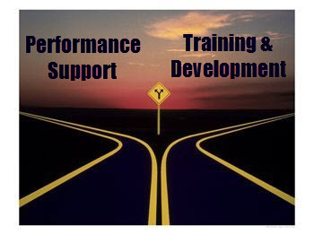
In January 2014, I accepted an offer to work exclusively with Mindmuze as a Senior Instructional Designer.
Performance Support
Developing a performance support solution for the global KPMG partnership has been challenging and rewarding. The best part is seeing the finished product!
Training & Development
Throughout the process of drafting training curriculum, designing storyboards and developing the content, being an instructional designer just guarantees that my career development path will continually cycle back to the beginning as a lifelong learner.

Slide 28
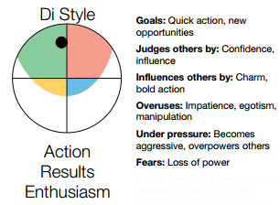
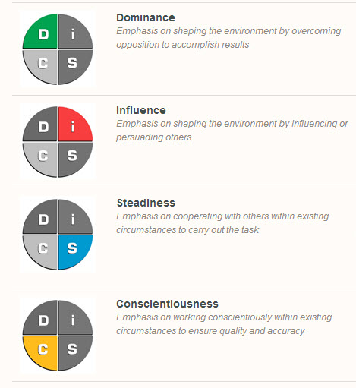
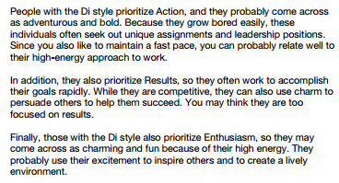
DiSC - Inspirational profile
I’ve kept up with my DISC profile for most of my career. It’s changed somewhat, but what remains steady is that I am a solid Di. I appreciate that this system helps me understand a better approach for interacting with folks whose styles are different from mine.

Slide 29

I’m Best At:
Seeing the big picture
Identifying skill and experience gaps and inspiring improved performance
Strategic and analytical thinking
Ambiguity tolerance
Tearing processes apart, fixing them, and putting them back together
Staying cool in a fast-paced, noisy, stressful environment
Interacting with tons of people throughout the day

Slide 30
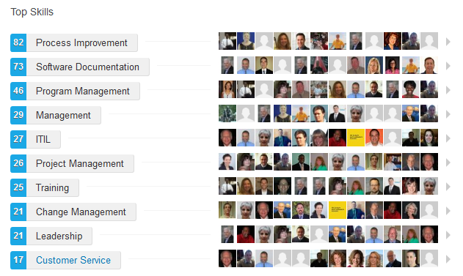
But don’t take my word for it. . .
What people who know me think are my skills and expertise.

Slide 31
But don’t take my word for it. . .
I have had the pleasure of working with Tammy on the design and build of an e-learning project for a major client. Tammy was excellent throughout every stage. She worked tirelessly to ensure that everything was done as promised and added greatly to the project by recommending approaches that enhanced the overall learning effectiveness of the program. Tammy is knowledgeable, patient and personable - just who I needed to help guide me through the challenges of this project. I look forward to working with Tammy on future projects and would enthusiastically recommend her work to others.
Jim Baston, BBA Consulting Group, Inc. Management Consultant, Mindmuze Client
Tammy's qualities of conscientious dedication, customer service and continuous improvement would be a valuable asset in any workplace. My experience in observing her performance was that she developed strong skills quickly, shared knowledge willingly and constantly strove to improve. Tammy clearly feels a moral obligation to give an employer more than just going through the motions, and performs her tasks in a cheerful and open manner that builds trust and conveys honest appreciation for the others in her work group. So talk to Tammy if you're looking for qualities like that, but if you're looking for the typical mediocre employee that needs constant supervision to barely get the job done, then talk to someone else.
Rob McFarlin, PwC Communications Senior Manager
Tammy was a great asset to our operations team. She wrote, edited and updated instructional manuals and eLearning coursework. She was instrumental in building both the technical and live online proctoring call quality programs from the ground up including developing the form, establishing ratings and scoring, documenting standards, training the agents, executing assessments, leading calibration meetings, and reporting results to agents and leadership. Tammy’s attention to detail is unmatched. She has a passion for Service Excellence that is demonstrated with every assignment.
Wanda Cherry, B Virtual Program Manager
Tammy was a direct report at Arthur Andersen and valuable member of our Global Customer Support organization. She is enthusiastic and conscientious about her career. Tammy has broad experience in customer service, training, knowledge management, report analysis, etc. She demonstrates a positive, "can do" attitude with an eagerness to succeed.
Denise Cooper, PwC HRSSC Senior Manager

Slide 32
But don’t take my word for it. . .
By providing Melina and me with reference materials from the Help Desk Institute (HDI) including 2008 meeting proceedings, recorded transcripts & website access via your account, you gave us a solid foundation on the importance of a Service Catalog and corresponding components/considerations.
You coached us on key components of Information Technology Infrastructure Library (ITIL), the most widely accepted approach to IT service management and helped us recognize which elements could be used to satisfy our HR needs. This foundation provided Melina with the confidence necessary to meet with all the teams within the HR SSC to begin documenting the services they deliver.
I cannot count the many evenings you stayed to answer our questions and help us refine our Service Level Agreement template. You patiently explained how Service Manager could be utilized by the teams to quantify measurable services and helped our team map out and implement a new product and support matrix for HR KnowledgeSource so that we might test the waters and be advocates for the rest of the department . . .walk the talk if you will.
During your work on the HR SSC's dashboard project, you continued to identify ways in which Process Documentation and Reporting could collaborate and help the teams recognize the relationship between their dashboards and the measures they were asked to capture in their SLAs. You supported bringing representatives from our teams plus Strategic Transformation and the Call Center to the table to discuss how we could work more collaboratively on our individual projects to minimize stress to the teams yet demonstrate progress toward our individual deliverables.
You enthusiastically reviewed our templates and challenged us to think critically, consistently asking ourselves and the teams if the services we were documenting could be measured. You've established yourself as a valuable resource for the entire team as well as a trusted coach whom the team could engage for guidance in my absence.
We're thrilled that the HR SSC leaders have placed you on assignment with Process Documentation to help finalize the first round of Service Level Agreement. It is fitting that you receive credit for your outstanding contributions to this important project -- not just at the end, but throughout its lifecycle.
Carla Anzalone, PwC Process and Documentation Team Manager

Slide 33
But don’t take my word for it. . .
Tammy was fully engaged as a stakeholder on the Service Manager 7 project. She attended most meetings including stakeholder updates, design reviews and training updates over the course of the year. Tammy's active participation on behalf of the HR Call Center was especially important for meetings on Service Desk, Knowledge Management (KM) and Employee Self Service (ESS) system components.
These meetings, particularly requirements gathering and design review sessions can be difficult to follow, but Tammy remained attentive and actively contributed feedback, ideas, concerns, suggestions, etc. Tammy leveraged her experience in both the HR and IT call centers to translate or compare processes in the data administration/field mapping sessions.
Tammy owned the Service Manager 7 training process for the entire HRSSC back office (~100 staff) including attending and coordinating training for all HRSSC SM7 trainers, providing training materials, and co-leading every session. Tammy also helped to coordinate QA testers. In both instances Tammy's assistance saved the core project team time and let us focus on other areas of concern.
Jeff Walters, PwC Senior Project Manager (Service Manager 7)

Slide 34
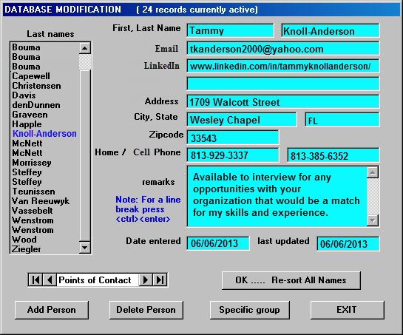
Want to CONNECT?
Reach out with:
A call
A text
Inbox on LinkedIn
An email
Snail mail
Use whatever your preferred communication channel is to connect with me!

